Slide 1

IOT-BASED SMART CITIES : INTELLIGENT GARBAGE COLLECTION Github link: https://github.com/vyshnavapuranampoojasri/IOT_BASED_SMARTCITY.git
Batch No: A-14 Project Guide:
POOJASRI V (174G1A0552) C. SASIKALA, M.Tech, Ph.D
HARSHITHA P (174G1A0522) Associate Professor
VANAJA R (184G5A0506)
LIYAKATH S (174G1A0532)
Srinivasa Ramanujan Institute of Technology
Department of Computer Science & Engineering

Slide 2
Contents
Introduction
Abstract
Existing System
Proposed System
Problem Statement
Components Description
Design & Implementation
Outputs
Conclusion
References

Slide 3
Introduction
A smart city is an urban area that uses different types of electronic methods and sensors to collect data. Insights gained from that data are used to manage assets, resources and services efficiently.
In other words, smart city is the one which has digital technology embedded across all the city functions. It also uses ICT (Information and Communication Technologies) to provide better quality and performance.

Slide 4
Abstract
Increasing population density in urban areas demands the necessity of intelligent services to meet the needs of the city’s residents.
An emerging solution to deal with this scenario is the convergence of information and communication technologies through the implementation of the concepts of smart cities and Internet of Things to provide solutions in diverse fields like infrastructure, transportation, and surveillance.
The efficient management of these kinds of services has a significant impact on the quality of life of the citizens.

Slide 5
The garbage collection system is an important component of urban infrastructure. It is difficult to locate the exact garbage bin which is facing the problem. Therefore, it is essential to develop a system which can handle intelligent garbage collection without human intervention. Hence, this project aims to design intelligent garbage collection system using IoT .

Slide 6
Existing System:
A waste-bin system can be adapted into general waste-bin and it consists of the sensing units, a Bluetooth and GSM Module for data transmission, and a mobile application and web-based monitoring for interfacing and communication with the waste department for waste management.
The smart bin is composed of sensor node mounted on it for the data collection and transmission. The sensors are divided into two path. One path is mounted with the bin cover and the other is in the bottom of the bin. The first path is level sensor to monitoring the level of waste-bin. The other path is smart load cell sensor to calculate the weight of waste.

Slide 7
Proposed System
The Proposed system assures the collection of garbage soon when the garbage level reaches its maximum level. The system will thus provide accurate reports, increasing the efficiency of the system.
The real time monitoring of the garbage level with the help of sensors and wireless communication will reduce the number of trips required by the garbage collection vehicle and thus will reduce the total expenditure associated with the Garbage bin.

Slide 8
Problem Statement:
The main concern with our environment has been waste management which impacts the society in several ways. The Detection, Monitoring & Management of waste is one of the major problem of present era.
The garbage collections system is an important component of urban infrastructure. It is difficult to locate the exact garbage bin which is facing the problem. Therefore, it is essential to develop a system which can handle intelligent garbage collection without human intervention. Hence, this project aims to design intelligent garbage collection system using IoT.

Slide 9
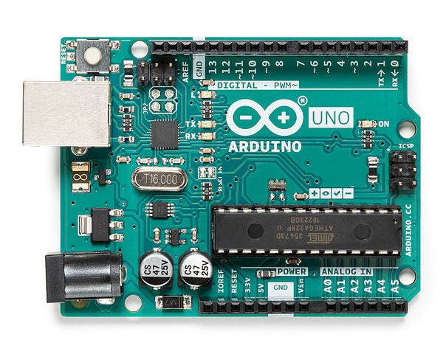
Components Description:
Arduino uno R3 :
Arduino is an open-source electronics platform based on easy-to-use hardware and software. Arduino boards are able to read inputs - light on a sensor, a finger on a button, or a Twitter message - and turn it into an output - activating a motor, turning on an LED, publishing something online.

Slide 10
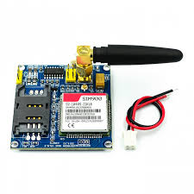
GSM SIM 9A:
The SIM900 is a complete Quad-band GSM/GPRS solution in a SMT module which can be embedded in the customer applications. Featuring an industry-standard interface, the SIM900 delivers GSM/GPRS 850/900/1800/1900MHz performance for voice, SMS, Data.

Slide 11
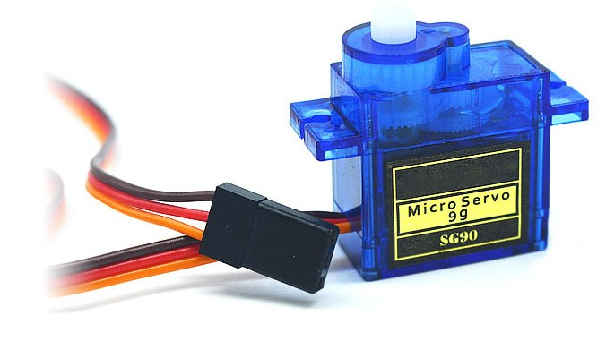
Servo motor :
Servos are controlled by sending an electrical pulse of variable width, or pulse width modulation (PWM), through the control wire. There is a minimum pulse, a maximum pulse, and a repetition rate. A servo motor can usually only turn 90° in either direction for a total of 180° movement.

Slide 12
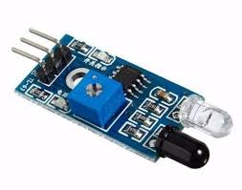
IR sensor:
An infrared sensor is an electronic device, that emits in order to sense some aspects of the surroundings.

Slide 13
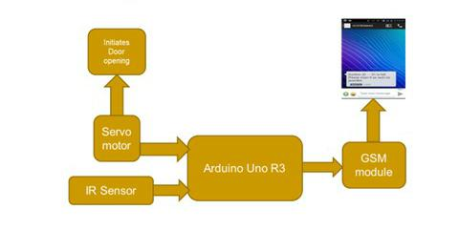
Design & Implementation

Slide 14
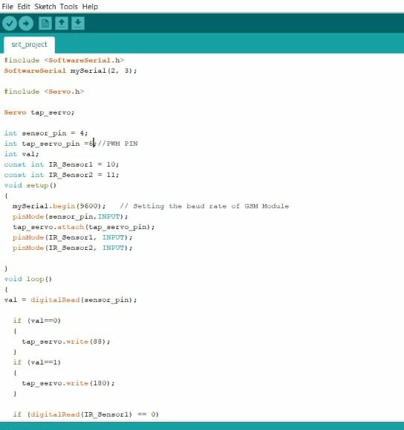

Slide 15
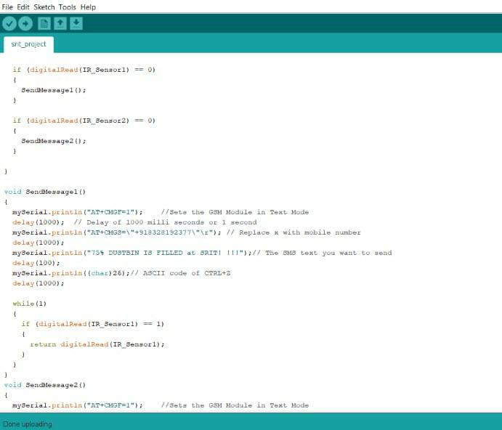

Slide 16
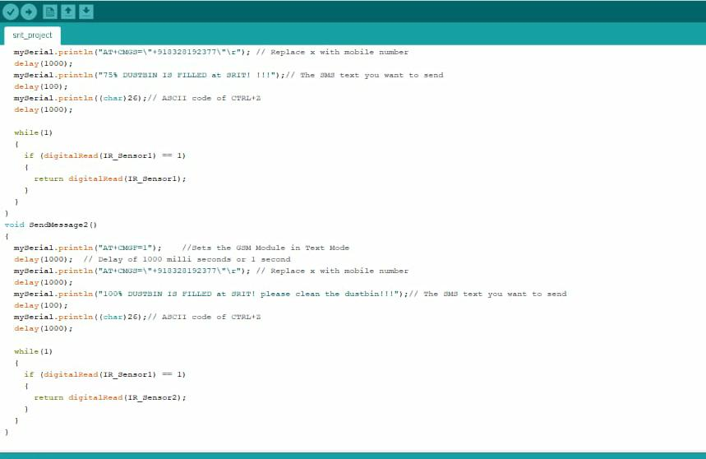

Slide 17
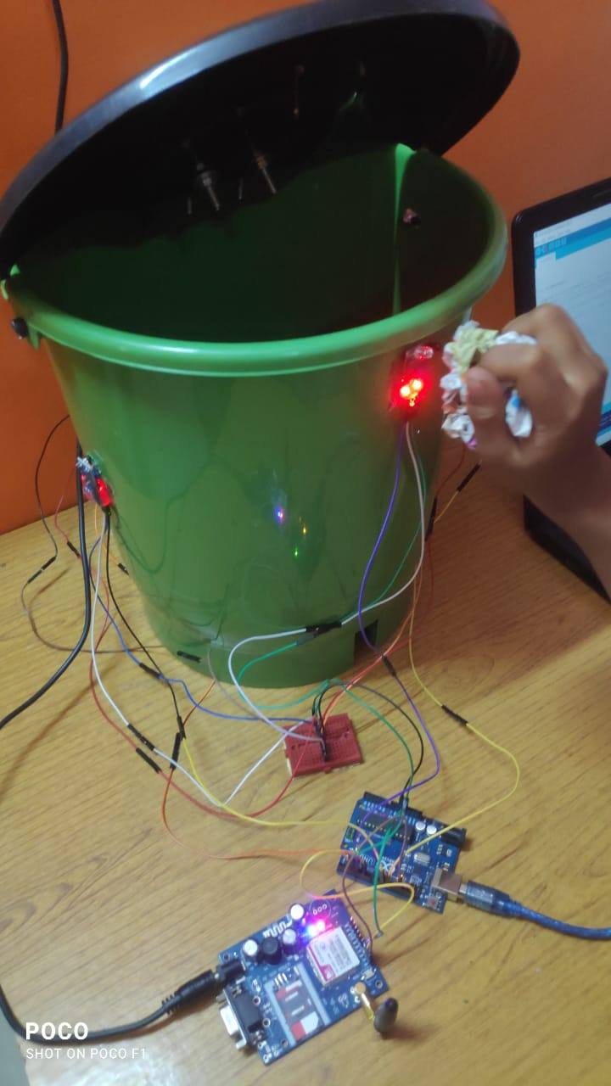
Outputs

Slide 18
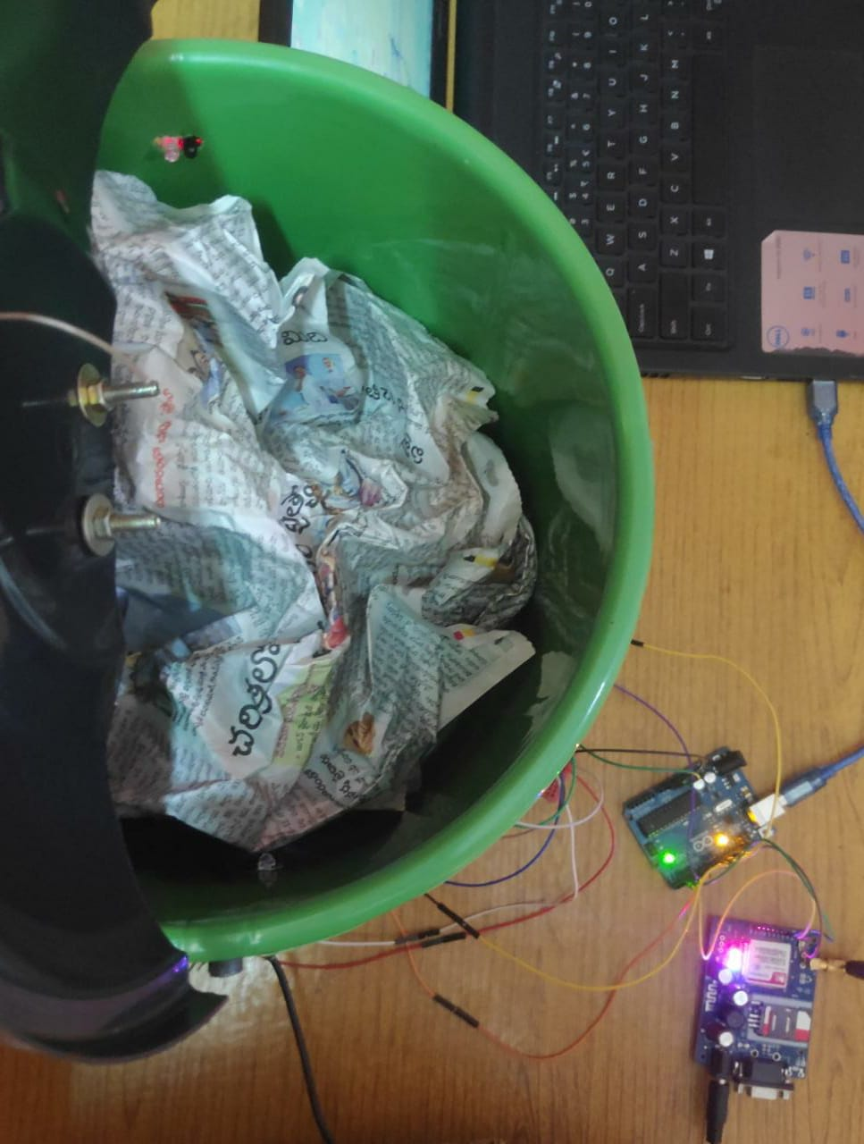
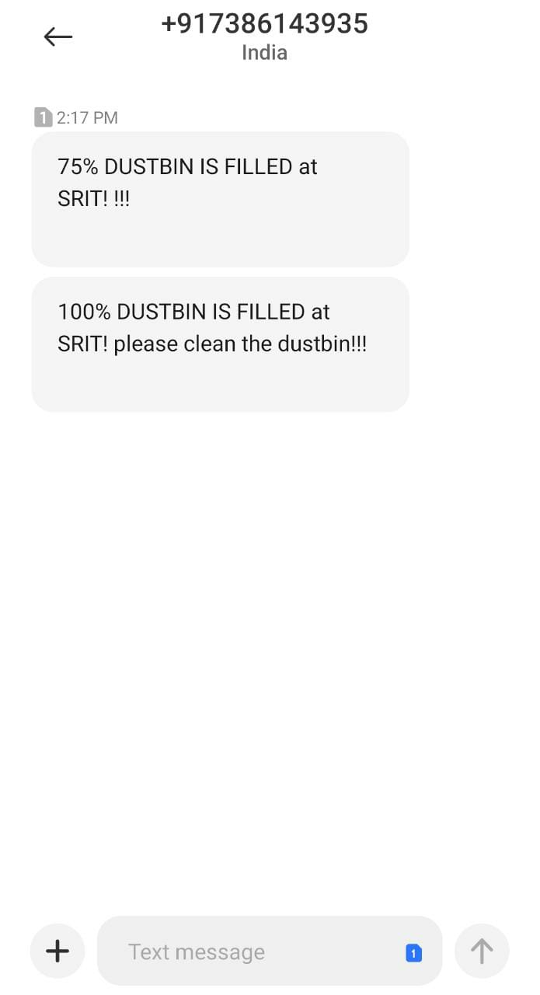

Slide 19
Conclusion
This system helps the local municipal administration in waste management system i.e., monitoring of domestic wastage clearance at proper time to avoid damage to the public health.

Slide 20
References
H. Arasteh, V. Hosseinnezhad, V. Loia, A. Tommasetti, O. Troisi, M. Shafie- khah, P. Siano, Iot-based smart cities: a survey, in: 2016.
A.S. Bharadwaj, R. Rego, A. Chowdhury, Iot based solid waste management system: a conceptual approach with an architectural solution as a smart city application, in: 2016.
Prakash , Prabu, “ IoT Based Waste Management for smart city” published in IJRCCE Volume4 , Issue 2 , February 2016.
Alexey Medvedev, Pert Fedchenkob,, A Arkady Zaslavsky, “ Waste Management as an IoT Enabled Service in Smart Cities”, Springer 2012.

Slide 21
Thank you
Queries
?

